Slide 1
Team 7: CMT4J
Nithin Parsan, John Yang, Yunseo Jo, Alex Quach

Slide 2
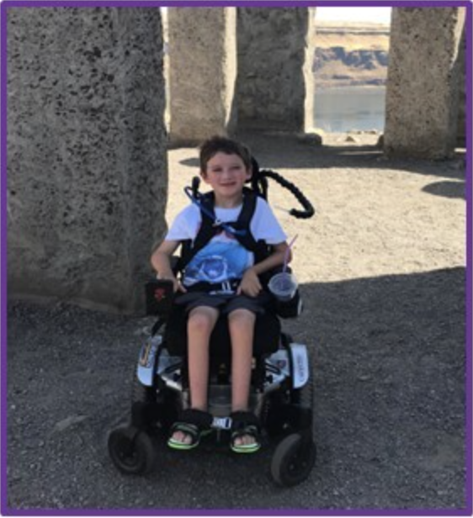
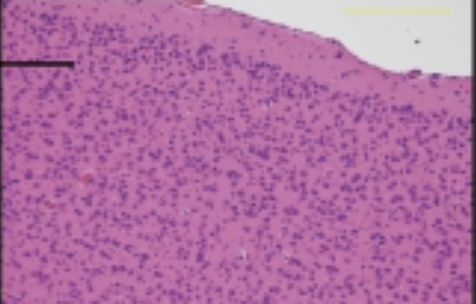
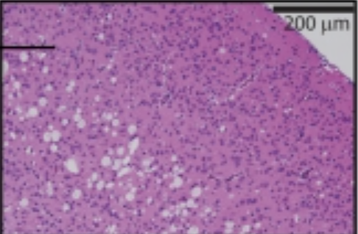
Background on CMT4J
CMT4J is an ultra-rare form of hereditary neuropathy (1/1,000,000).
Caused by a mutation in the FIG4 gene:
Autosomal recessive inheritance, commonly I41T/null (60/100).
Mutation reduces binding affinity but can be rescued.
Clinically presents itself with high variability, often misdiagnosed e.g. CIDP.
AAV gene therapy recruiting for clinical trial.
Vacuolation => spongiform encephalopathy (Lenk 2011)

Slide 3
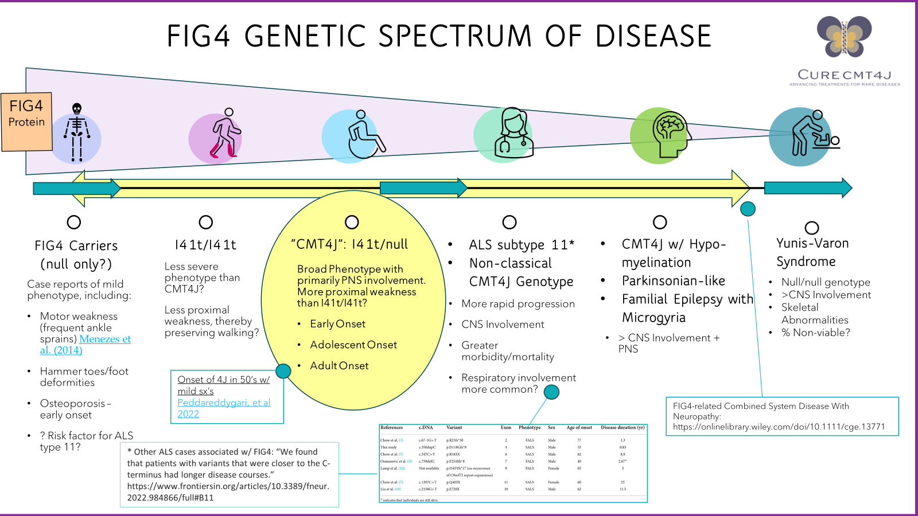
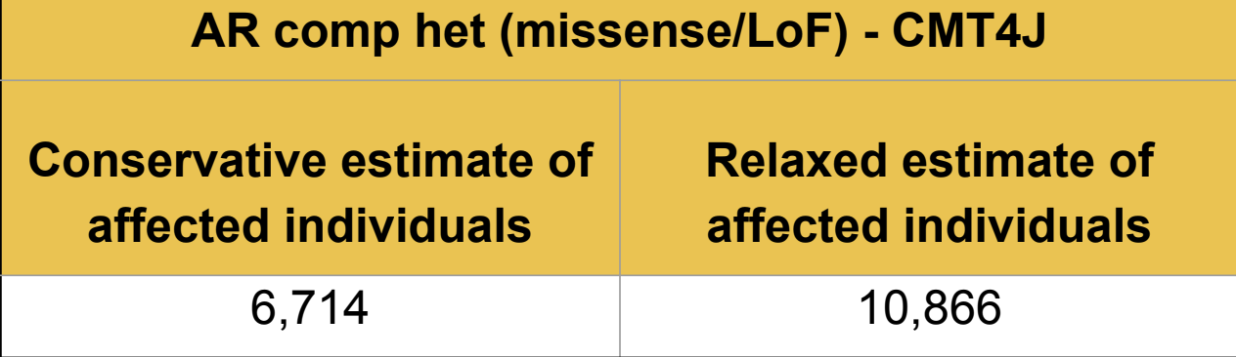
FIG4 Variants Are Difficult to Categorize
Lack of data for non-classical genotypes, affects clinical trial eligibility.
FIG4 disease severity varies significantly. Why?
Broad Institute frequency analysis says there should be more 4J cases.

Slide 4
Goal: Characterize FIG4 Variants Using in silico Methods and Case Studies To Compensate For Low Sample Sizes
Data
Methods
ClinVar, gnomAD variants of FIG4
AlphaMissense predictions for AA mutation pathogenicity
Correlate Pathogenicity with in silico Binding Affinity Data
Easy-to-compute, general across diseases, relevant for AAV trial
Case Studies of 4J, ALS-11, YV, etc.
Score FIG4 Variants in Literature Across The Spectrum
Many Variants of Unknown Significance (VUS), in-silico scoring is cheap preliminary look.
Fig4 + Vac14 structure

Slide 5
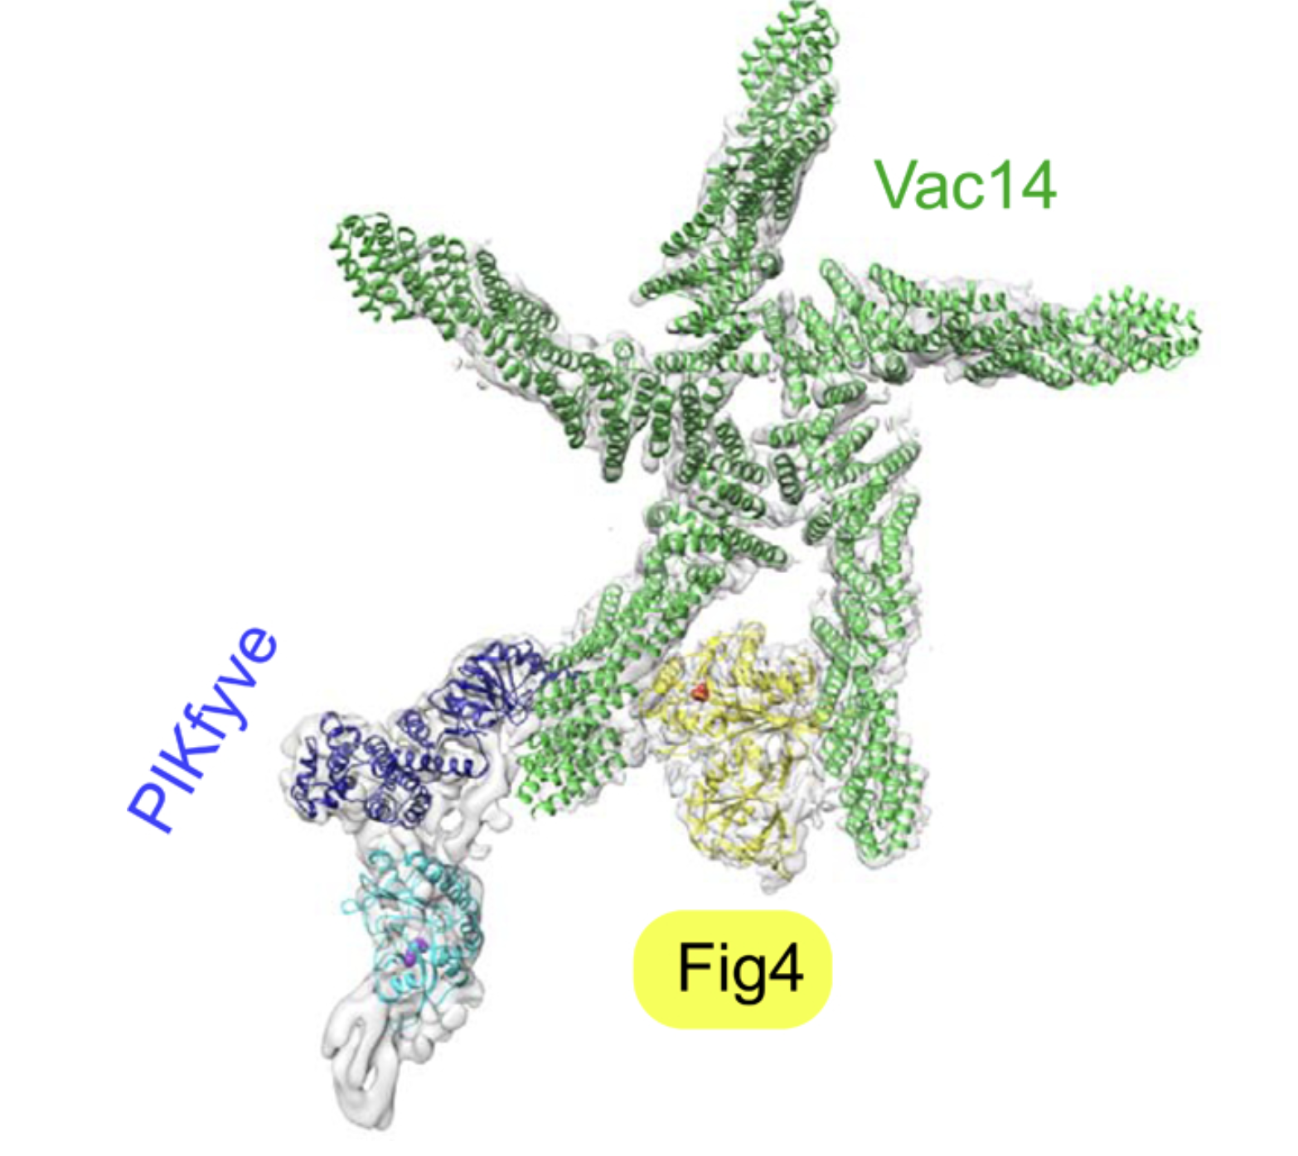
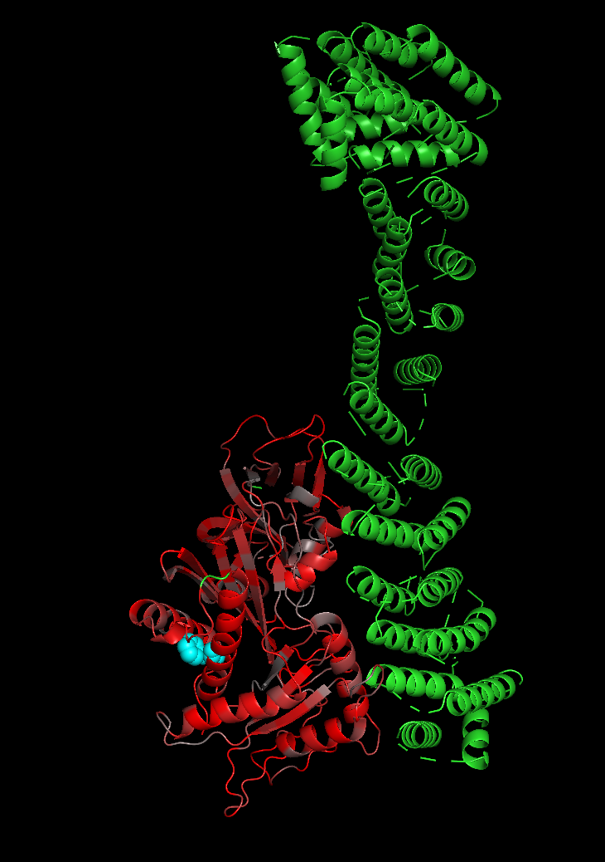
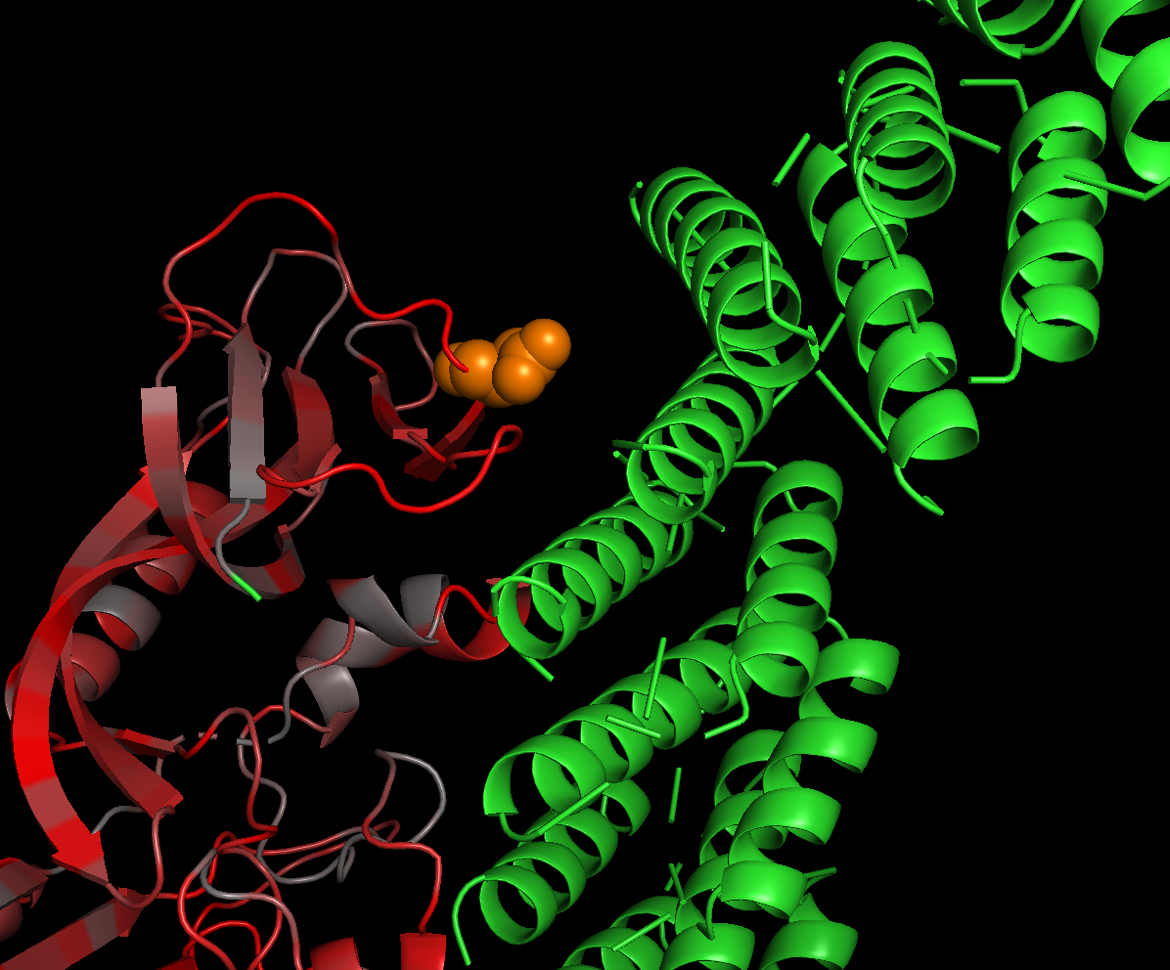
Results
Binding complex visualization enriched with predicted pathogenicity
Predicted binding complex of Vac14 and Fig4 generated using MegaDock
Residues colored according to average missense pathogenicity
High pathogenicity at binding interface and active site
I41T has very high predicted pathogenicity (0.97)
Near binding interface of Vac14
Loop residues all >0.95 predicted pathogenicity
I41T

Slide 6
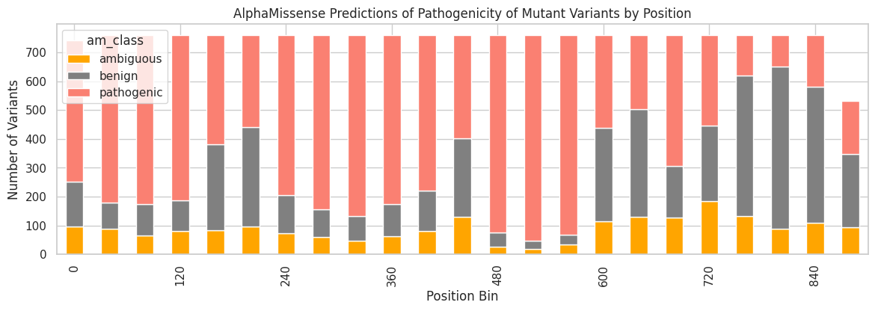
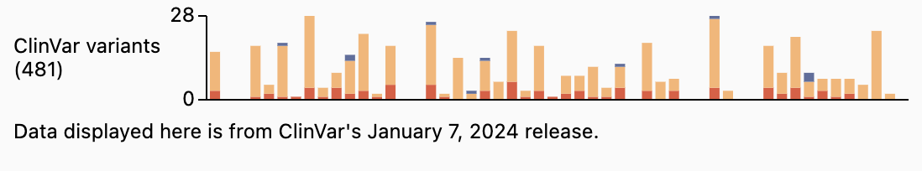
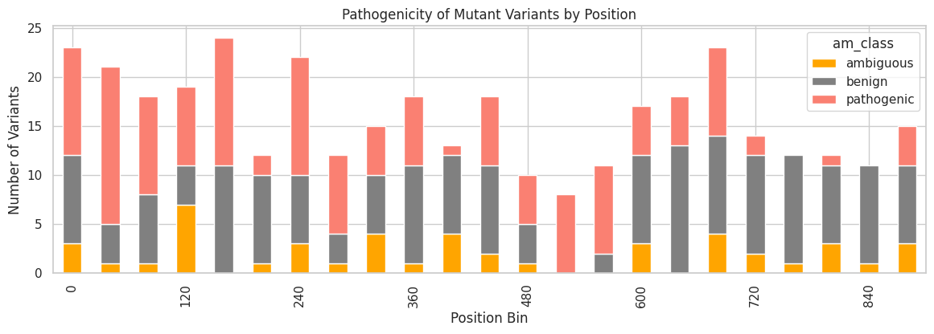
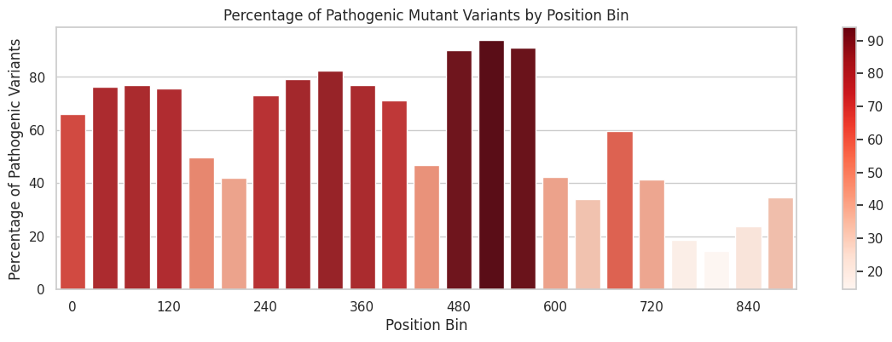
Results
ClinVar annotations for mutational landscape (many uncertain VUS)
AlphaMissense predictions resolve VUS
AlphaMissense predictions of all FIG4 missense mutations show high degree of pathogenicity from residue 480 - 550

Slide 7
Discussion + Future Directions
Future Directions
Use AI for protein optimization → novel AAV therapeutics with longer lasting + higher affinity FIG4
Investigate sphingosine 1-phosphate as immunogenic biomarker. Fingolimod could be therapeutic as in MS.
Discussion
Characterized 438 protein missense variants of FIG4 using AlphaMissense
Binding complex structure enrichment with predicted pathogenicity is validated by clinically relevant mutations

